Slide 1
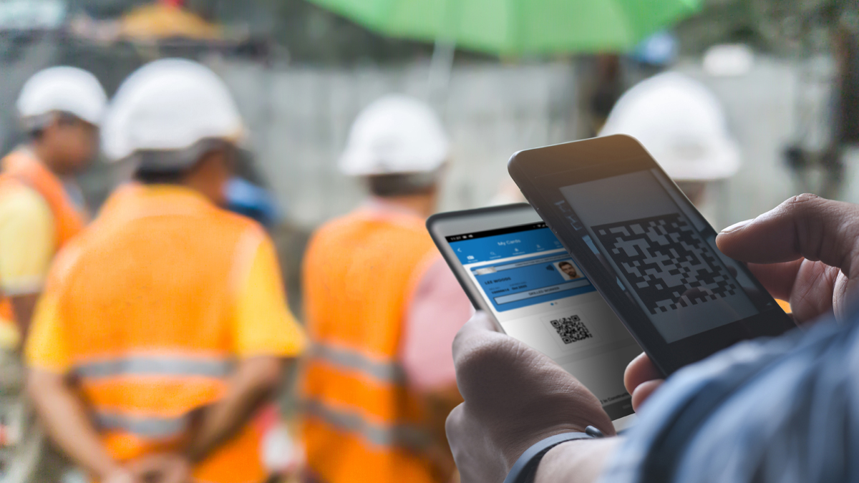
Webinar 4: 31st March 2022
Notes:
Welcome & introductions
Alan introduce the project team
Highlight that Build UK will be familiar with some of the content – but want to demonstrate what the rest of the industry will see/hear until we are in a position to deliver live demos
Today is about, background, functionality, what Build UK members should expect in April and how we intend to roll it out.

Slide 2
Overview
Raising standards in construction
The app is called CSCS Smart Check, and it is free
A card checking app for those responsible for checking cards on site
Not an app for individuals to store details of their cards, e.g. My CSCS, MyECS or Smart PAL
Cards that are not smart will have the option of using a manual entry check
Does not store info about the card or card holder – simply checks that the card is valid and displays info printed on the card
Available from 1st April: download from the Apple Store or Google Play Store
Onboarded in May: CSWIP, IPAF, ADSA, CISRS, LEEA, CPCS, ACE, MPQC, PASMA, SAFed, SEIRS, Trainthepainter, ICATS.

Slide 3
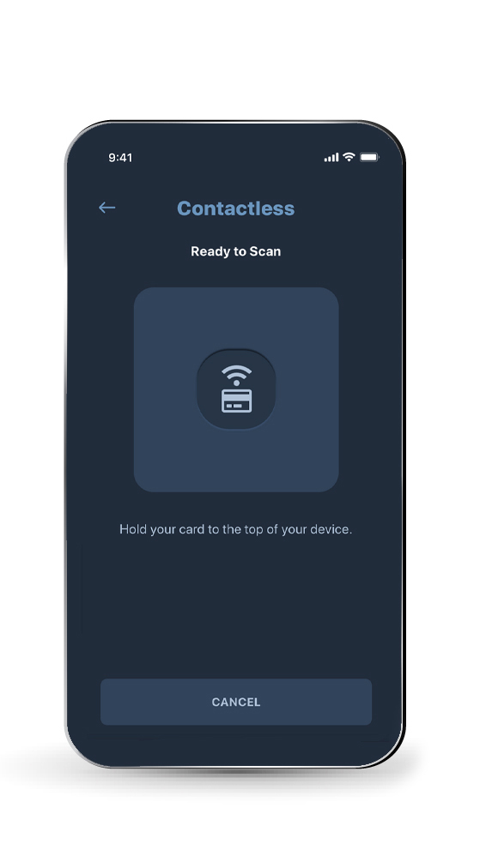
Background
Raising standards in construction
Importance of card checks:
Appropriate training and qualifications
Improved productivity and site safety
Tackle fraud
Existing card checking procedures:
38 card schemes
Incompatible technologies
Issues:
Unrealistic expectations
Confusion, leading to poor checking practices
Increased risk on site
Notes:
Importance of card checks – expand on bullet points
Existing card checking procedures – expand on the various techs available through to those with no tech
Expand on the complexities and incompatibility
Expand on the issues/risks as per bullet points

Slide 4
Complexity
Raising standards in construction
Notes:
A visual demonstrating the complexity of the current card checking landscape and the size of the challenge for the Alliance.

Slide 5
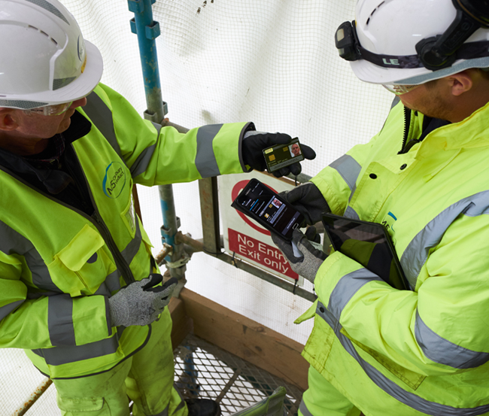
Raising standards in construction
The Challenge
Construction Leadership Council:
“By 31 March 2022, all card schemes must use smart technology which has the capability to electronically check agreed information relevant to a cardholder, using a common interface, without the need to manually enter data.“
Aims:
Increased use of technology
Ensure all cards are genuine & in date
Workers hold the appropriate training and qualifications
Results:
Improved standards, productivity and safety
Notes:
Issue acknowledged by the CLC and requirement updated in October 2020

Slide 6
Raising standards in construction
Our approach
Working Group:
6 cards schemes represented
The process:
Investigation / benchmarking
Optioneering / preferred solution (app)
Supplier selection
Key principles:
Low cost, minimal change, ease of use, GDPR
Free: Apple iOS and Android - connection required
Initially standalone, existing systems not compatible
Transition: “roll out” not “big bang”
Notes:
Background to the Working Group – 6 Alliance members – selected based on differing technologies – StableLogic programme management
Expand on the key steps taken to reach the preferred solution (as per bullets)
Important to highlight all 38 card schemes engaged throughout this process with the Working Group doing the heavy lifting on behalf of all
Brief explanation of the supplier selection process leading to ICREON
Expand on the key principles – agreed by all 38 Alliance members

Slide 7
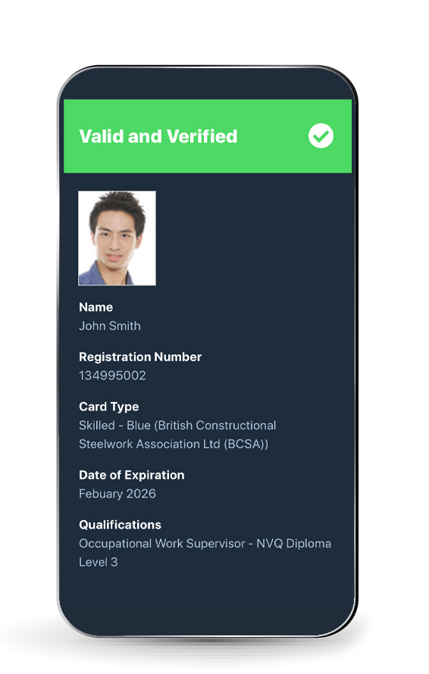
Raising standards in construction
How it works
Database:
Requires internet/mobile connection
What happens at the site gates?
Contactless
QR code
Manual
Support
Existing systems
April: no immediate impact
Period of transition
Employers expected/encouraged to migrate over time
Notes:
Explanation of the database and how it works
Description on how it works using contactless / QR code & Manual
Expand on support available/signposts within the app for when something goes wrong
Existing systems – reinforce the standalone message – acknowledge existing systems (turnstiles/card readers) are out of scope, no immediate impact on existing operations – period of transition (multiple systems).
Explain that current systems will still continue to work as they currently do and we will be working to transition everyone across to the new App and process over time once further developments are implemented

Slide 8
Raising standards in construction
What next?
Notes:
Expand on key milestones: Development / testing / early adopters /onboarding / ongoing comms / Go Live – “rollout” not “big bang”

Slide 9
Recap
Raising standards in construction
The app is called CSCS Smart Check, and it is free
A card checking app for those responsible for checking cards on site
Not an app for individuals to store details of their cards, e.g. My CSCS, MyECS or Smart PAL
Cards that are not smart will have the option of using a manual entry check
Does not store info about the card or card holder – simply checks that the card is valid and displays info printed on the card
Available from 1st April: download from the Apple Store or Google Play Store
Onboarded in May: CSWIP, IPAF, ADSA, CISRS, LEEA, CPCS, ACE, DSA, MPQC, SEIRS, Trainthepainter, ICATS.

Slide 10
Communications
Strategy:
Raise awareness
Direct engagement
Timeline:
Up to April 2022
Beyond April 2022
Priorities:
Preparing the industry
Supporting materials
Initially stand-alone - period of transition
Continued promotion - encourage uptake
Notes:
Run through of key deliverables from the Comms Strategy
Expand on the priority actions as per bullet points.

Slide 11
Questions?

